Slide 1
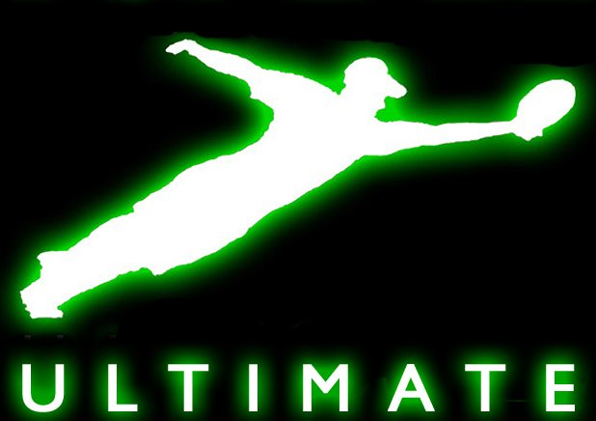
Ultimate Frisbee

Slide 2
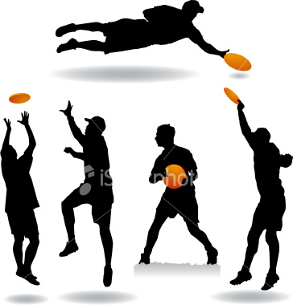
What is Ultimate Frisbee?
1. Ultimate is a non-contact sport played
with a 175 gram flying disc.
2. The object of the game is to score points by passing the disc to a player in the opposing end zone, similar to an end zone in American football or rugby.
3. Players may not run with the disc, and may only move one foot while holding the disc (pivoting).
While originally called Ultimate Frisbee, it is now officially called Ultimate because Frisbee is the trademark, for the line of discs made by the Wham-O toy company.
In 2008, there were 4.9 million Ultimate players in the US.

Slide 3
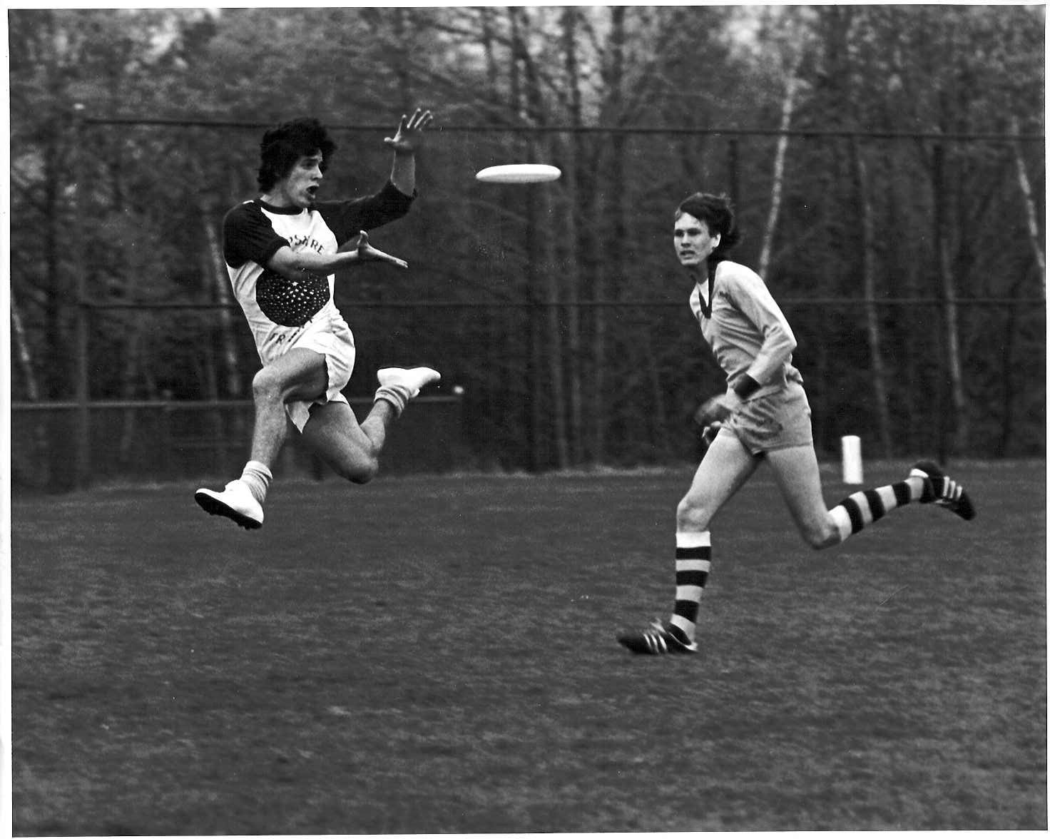
History
How did the game start?
In the fall of 1968, Joel Silver, a student at Columbia High School in Maplewood, New Jersey, proposed a school Frisbee team to the student council .

Slide 4
The Field
A rectangular shape with end zones at each end.
A regulation field is 70 x 40 with end zones 25 yards deep.

Slide 5
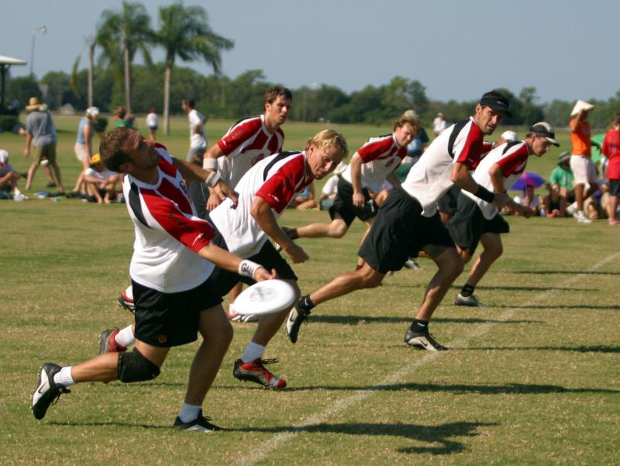
Initiate (Start) of Play
To begin play the ultimate players from each team line up on their end zones and the defense team pulls (throws) the disc to the other team as a "kick-off“ (called a Pull).
Pulls are long throws, and they are thrown in efforts of giving the offensive team poor field position and a chance for the defense to get down the field soon enough to stop advances.
Teams consist of 7 players each.

Slide 6
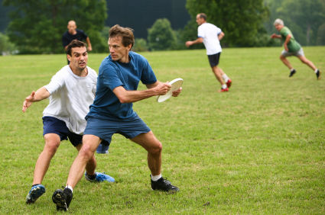
Movement of the Disc
The disc may be advanced in any direction by completing a pass to a teammate.
Players may not run with the disc.
The person with the disc ("thrower") has ten seconds to throw the disc.
One defender guarding the thrower ("marker") counts out the stall count.

Slide 7
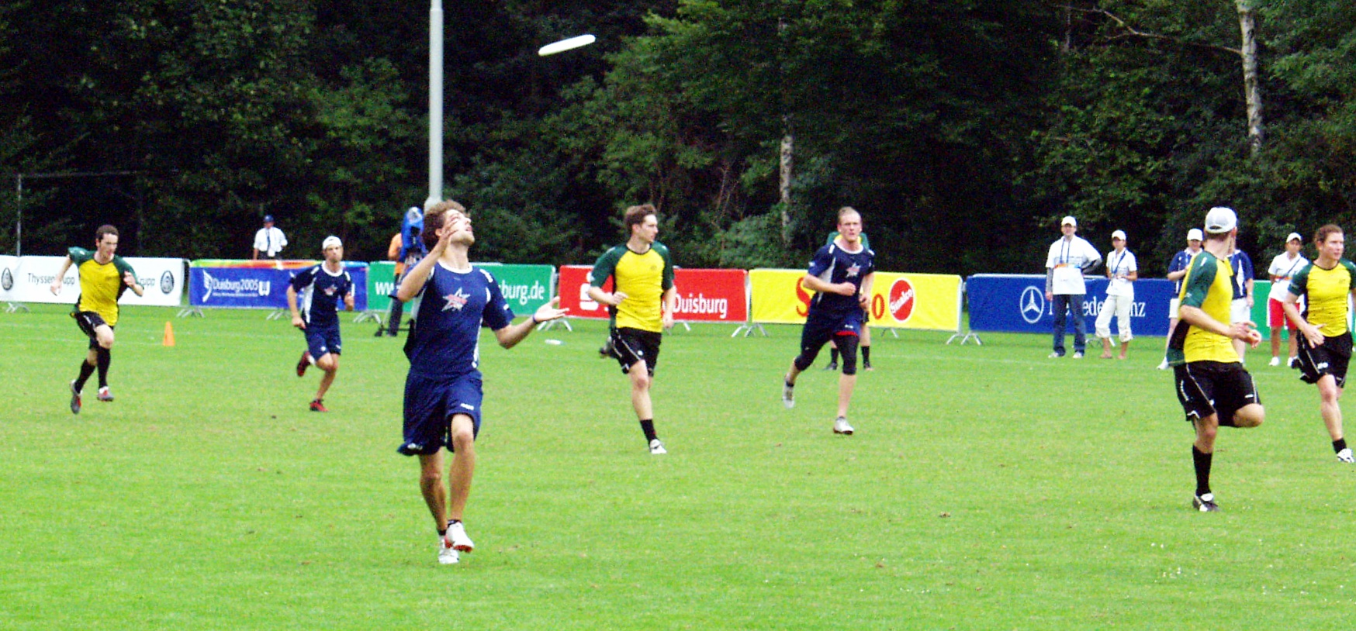
Scoring
A point is scored when a player catches a pass in the end zone his team is attacking.
Each time the offense completes a pass in the defense's end zone, the offense scores a point.

Slide 8
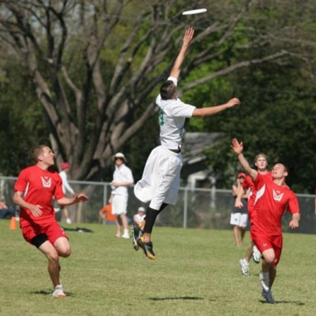
Change of Possession
Usually caused by a turnover
When this happens the defense immediately becomes the offense and gains possession of the disc where it comes to a stop on the field of play, or where it first traveled out of bounds.
Play does not stop because of a turnover.

Slide 9
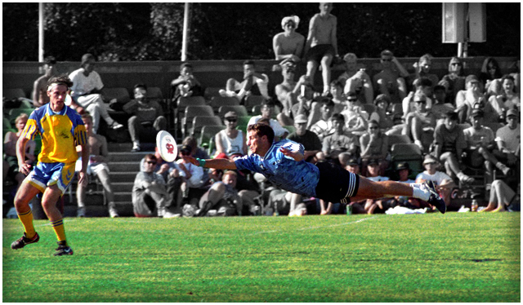
Reason for a Turnover
Throw-away — the thrower misses his target and the disc falls to the ground.
Drop — the receiver is not able to catch the disc.
Block — a defender deflects the disc in mid flight, causing it to hit the ground.
Interception — a defender catches a disc thrown by the offense.
Out of bounds — the disc lands out of bounds, hits an object out of bounds or is caught by a player who lands out of bounds or leaps from outside the playing field.
Stall — a player on offense does not release the disc before the defender has counted out ten seconds.

Slide 10
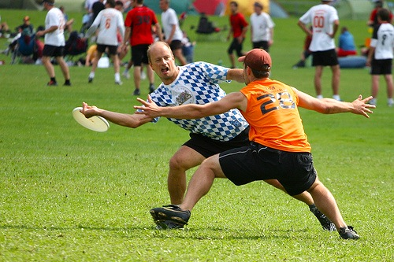
Non-Contact
No physical contact is allowed between players.
Picks and screens are also prohibited.
A foul occurs when contact is made.

Slide 11
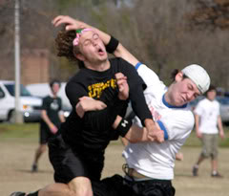
Fouls
A foul is the result of contact between players, although incidental contact (not affecting the play) does not constitute a foul.
When a foul disrupts possession, the play resumes as if the possession were retained.
If the player committing the foul disagrees with the foul call, the disc is returned to the last thrower.

Slide 12
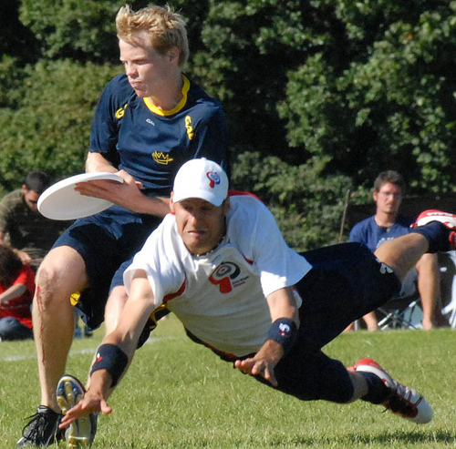
Self-Refereeing
Players are responsible for their own foul and line calls.
Players resolve their own disputes.
This creates a spirit of honesty and respect on the playing field.
It is the duty of the player who committed the foul to speak up and admit his infraction.
Occasionally, official observers
are used to aid players in refereeing, known as observers.

Slide 13
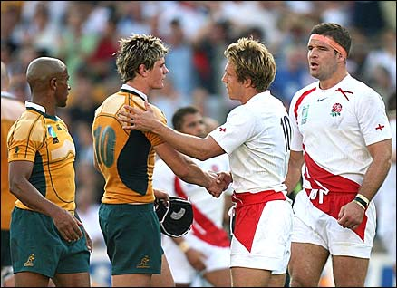
Spirit of the Game
Ultimate stresses sportsmanship and fair play.
Competitive play is encouraged, but never at the expense of respect between players, adherence to the rules, and the basic joy of play.

